Slide 1
CA-02 DATA VISUALIZATION
Objectives:
Comparative analysis of PCA,UMAP and t-SNE on Client and Patch dataset.
Critical analysis of different client features
Critical analysis of different patch details.

Slide 2
Exploring Clients and Patches Datasets
Clients
Patches
Clients Dataset consists of 43,193 rows with 9 different features.
It gives detailed information about clients of a unnamed bank.
Each row corresponds to a new client.
Patches Dataset consists of 15,120 rows with 7 features.
It gives cartographic information for different 30m × 30m patches in the forests of Alberta, Canada.
Each row corresponds to a observed patch..

Slide 3
Number of Subsets
We have created 6 subsets for clients dataset
We have created 4 subsets for patches dataset

Slide 4
Subset with the variable used.
Clients
Patches
Subset 1: job, marital, education,default, balance,housing,personal.
Subset 2: age, job, education, balance, personal,housing.
Subset 3: age, job, marital, balance, housing, personal,education.
Subset 4:job, marital, education, default, balance, housing,age.
Subset 5: age, marital, education, balance, housing, personal,job.
Subset 6: default,balance,housing,personal.
Subset 1 : Slope, Horizontal_Distance_To_Hydrology, Vertical_Distance_To_Hydrology, Horizontal_Distance_To_Roadways, Horizontal_Distance_To_Fire_Points.
Subset 2: Elevation, Slope, Horizontal_Distance_To_Hydrology, Tree.
Subset 3 : Elevation, Slope, Vertical_Distance_To_Hydrology ,Tree
Subset 4: Elevation , Slope, Horizontal_Distance_To_Hydrology, Horizontal_Distance_To_Roadways,Tree.

Slide 5
Methodology
Visualizing Clusters
Dimension reduction techniques using k-means labels
Applying k-means to generate labels
Data Pre-Processing

Slide 6
Comparative analysis of UMAP, t-SNE AND PCA
We tried to implement all three dimensional reduction techniques on both datasets and subsets for Clients and patches data.
PCA with k-means labelling was the worst amongst the three but divided very fast as compared to t-SNE.
T-SNE gave us amazingly good results but took at least 40 mins for each visualization.
UMAP was the best both with clustering and speed.
Hence UMAP is not only the most advanced technique but also the biggest reason for T-SNE being absolute.

Slide 7
Clustering Visualization for Clients data

Slide 8
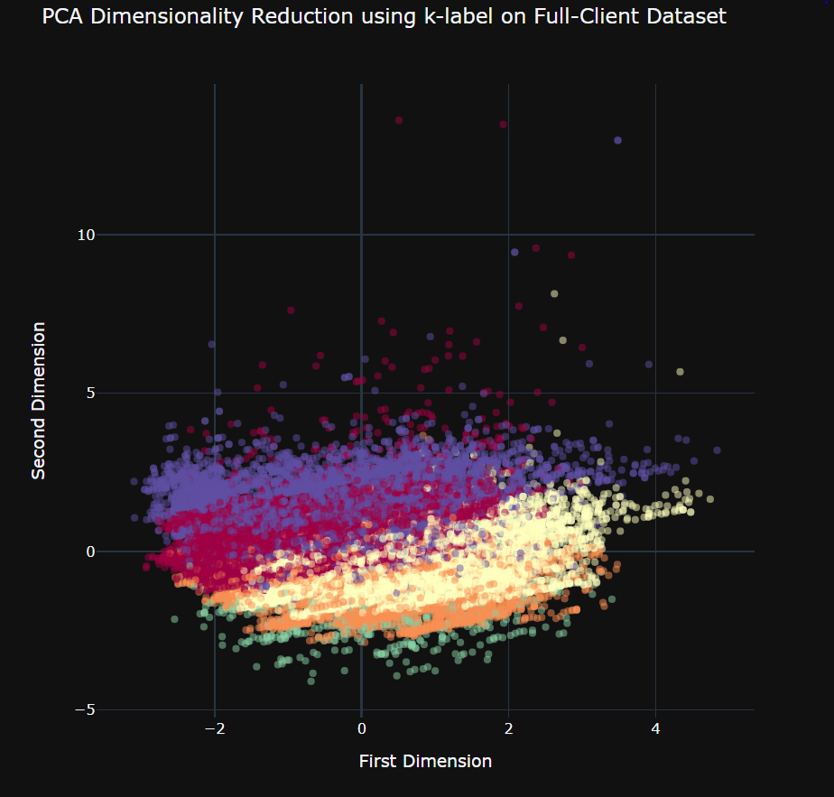
PCA on full Client dataset

Slide 9
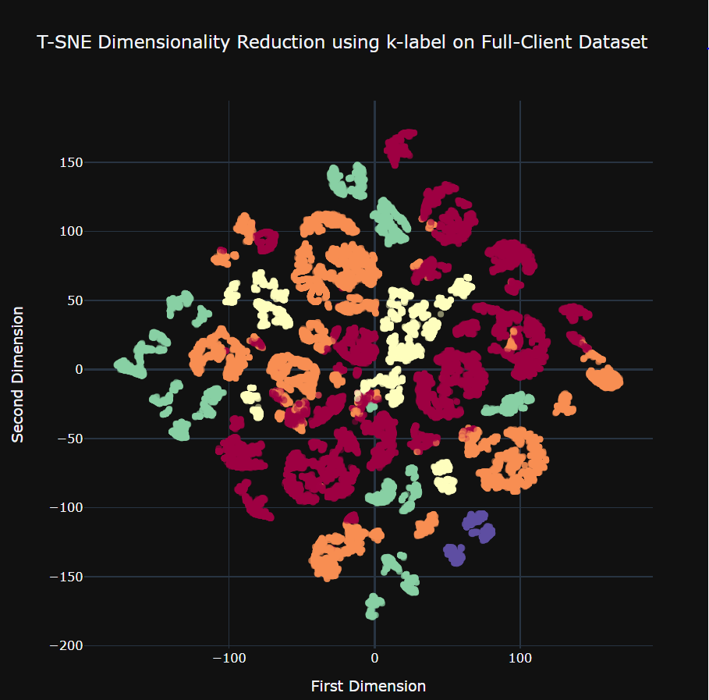
t-SNE on full Client dataset

Slide 10
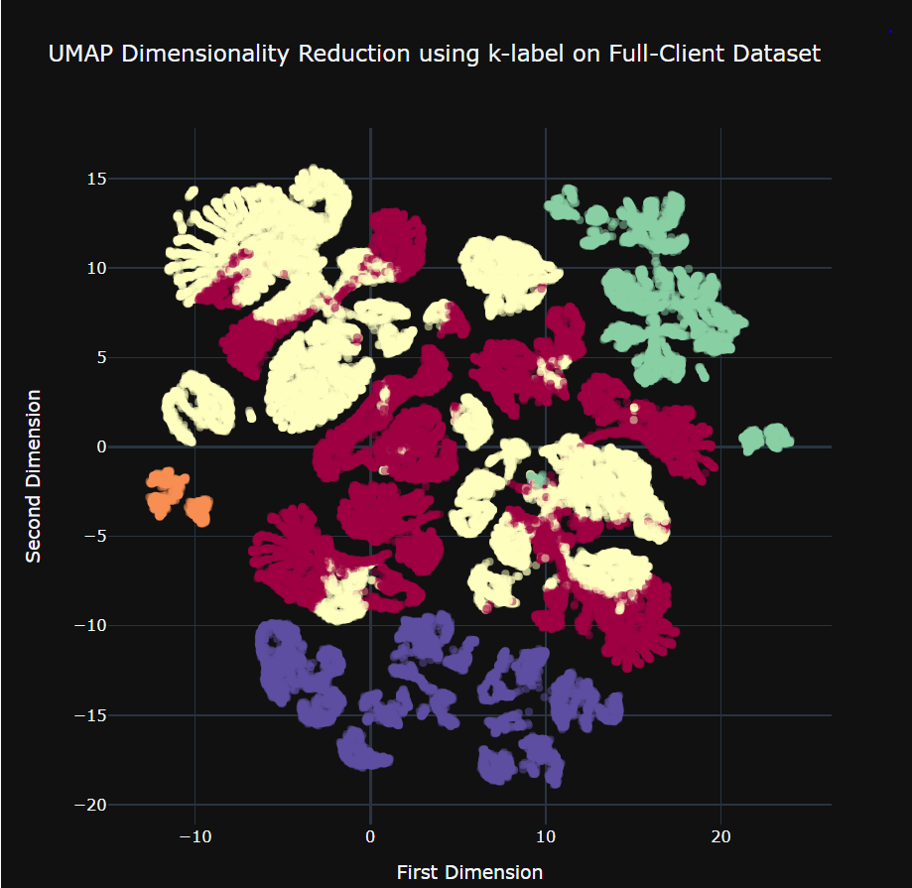
UMAP on full Client dataset

Slide 11
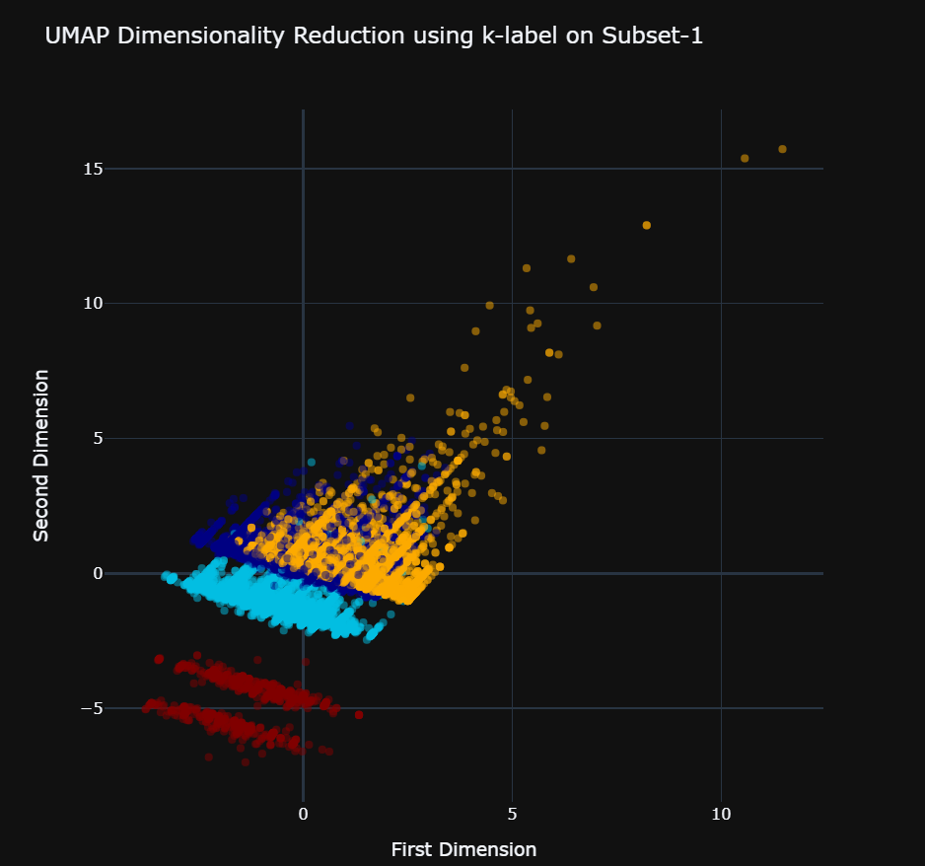
UMAP on Client subset-1

Slide 12
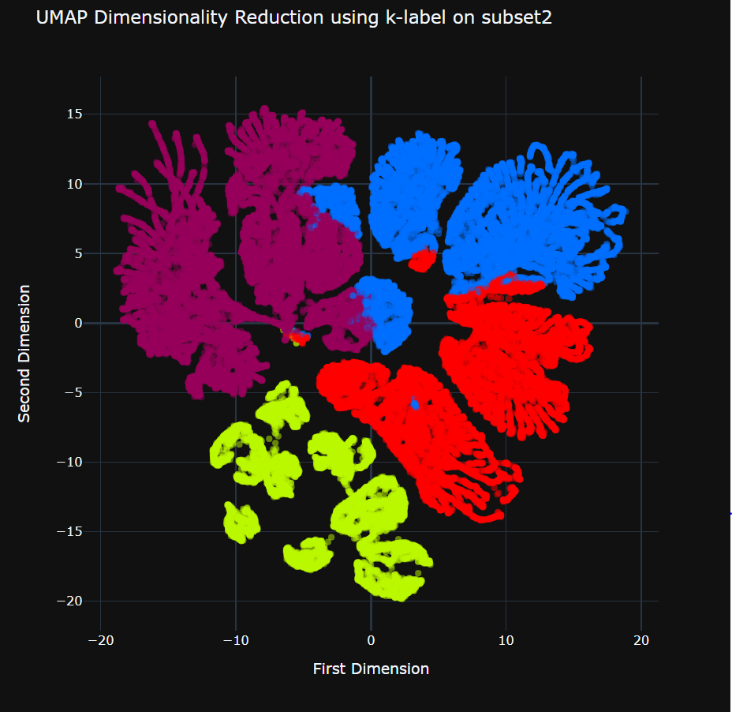
UMAP on Client subset-2

Slide 13
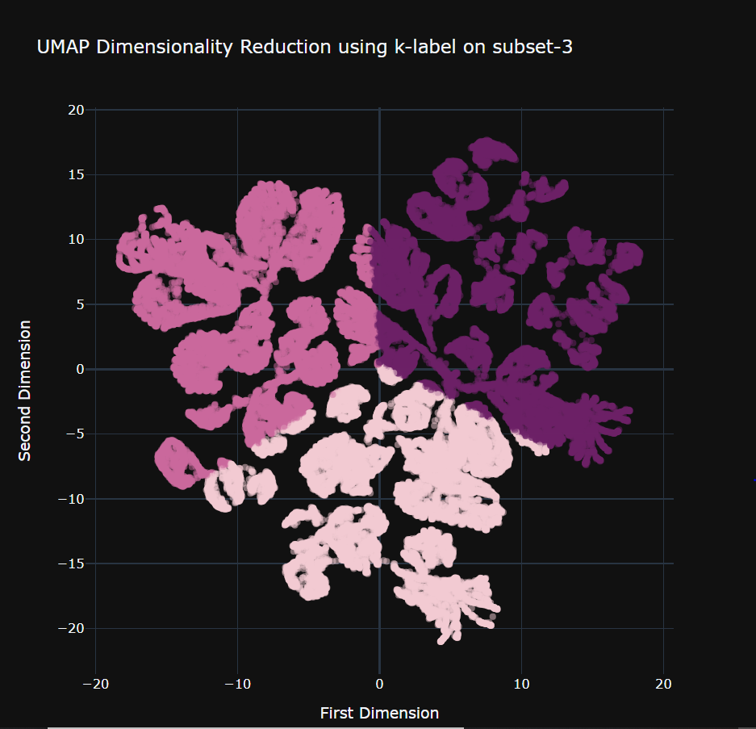
UMAP on Client subset-3

Slide 14
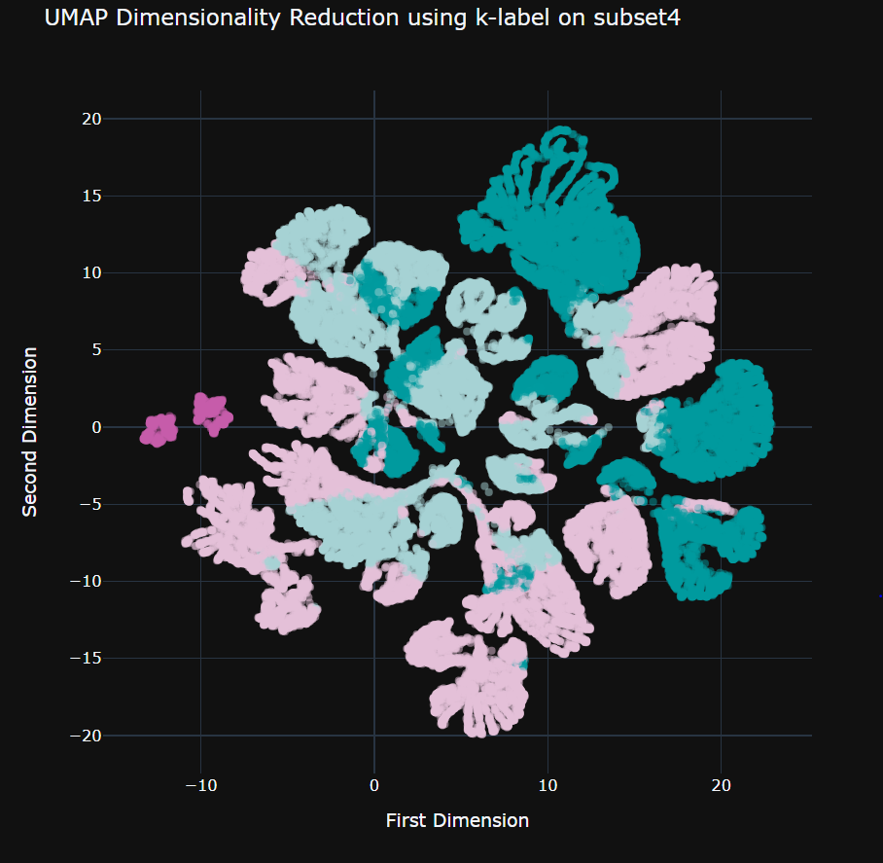
UMAP on Client subset-4

Slide 15
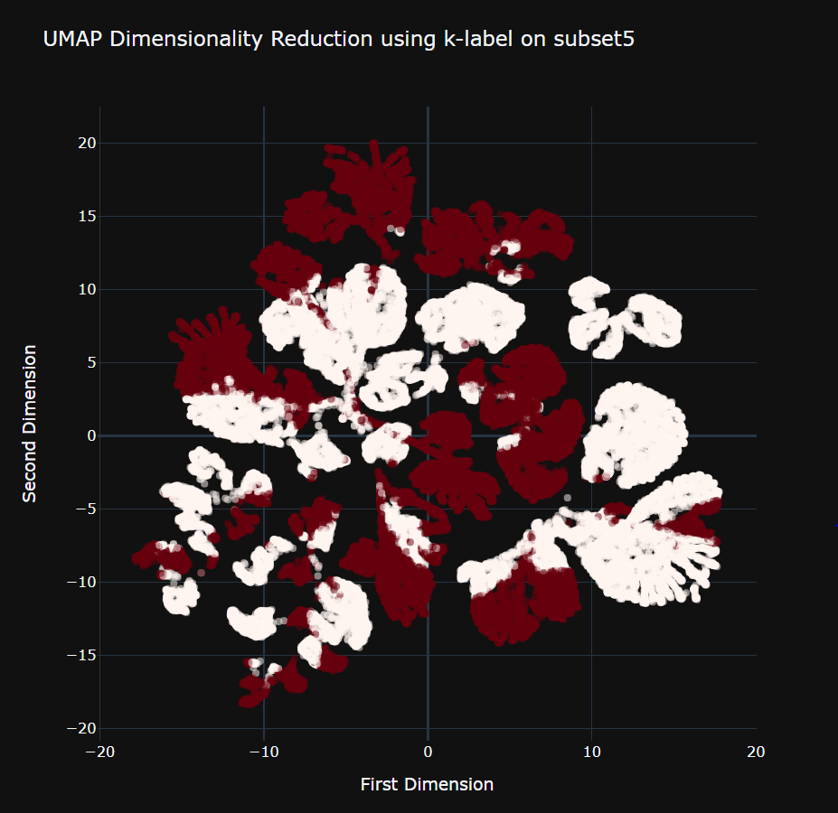
UMAP on Client subset-5

Slide 16
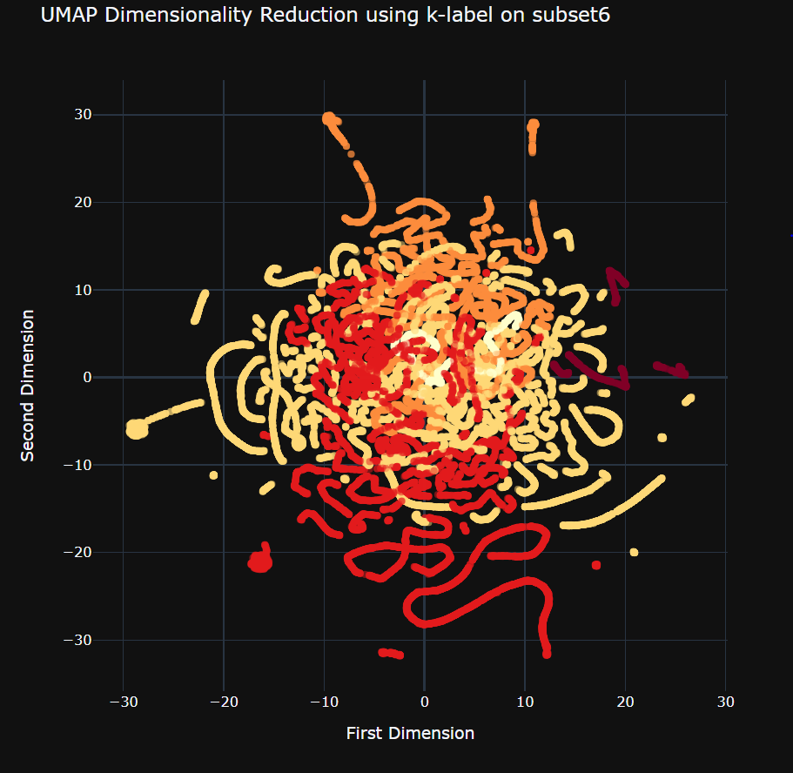
UMAP on Client subset-6

Slide 17
Clustering Visualization for PATCHES data

Slide 18
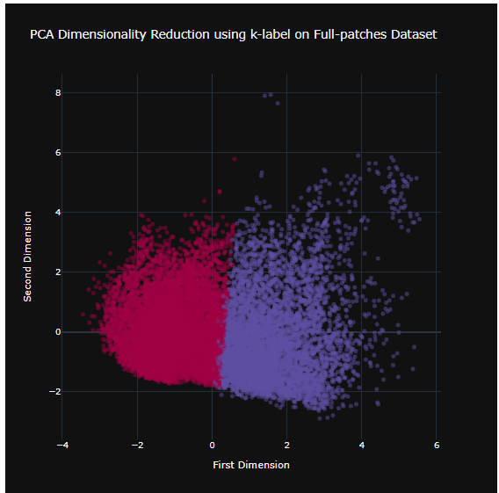
PCA on full patches dataset

Slide 19
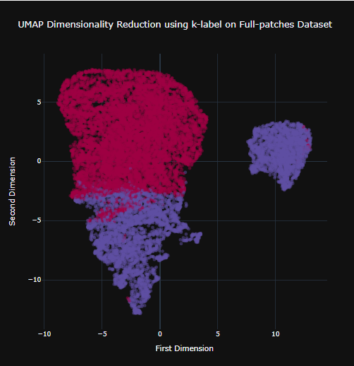
UMAP on full patches dataset

Slide 20
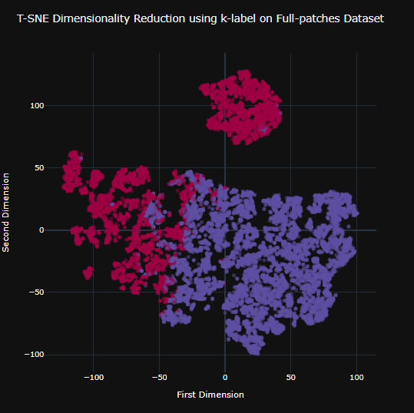
T-SNE on full patches dataset

Slide 21
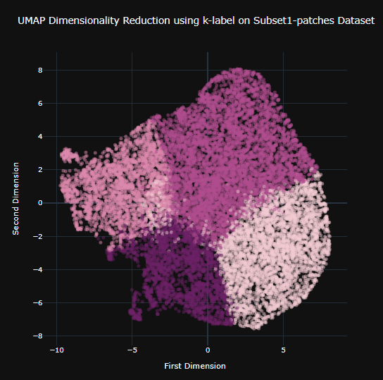
UMAP on patches SUBSET-1

Slide 22
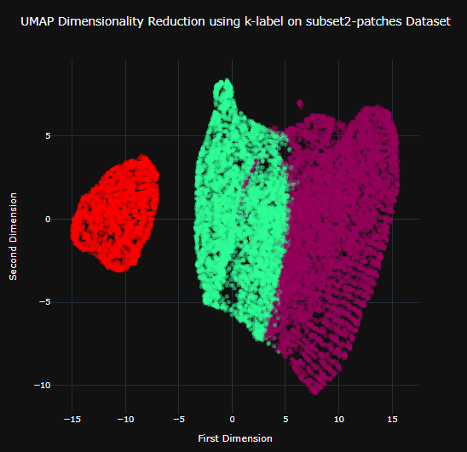
UMAP on patches SUBSET-2

Slide 23
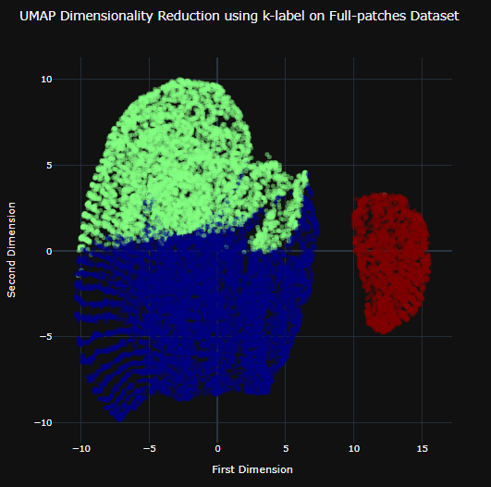
UMAP on patches SUBSET-3

Slide 24
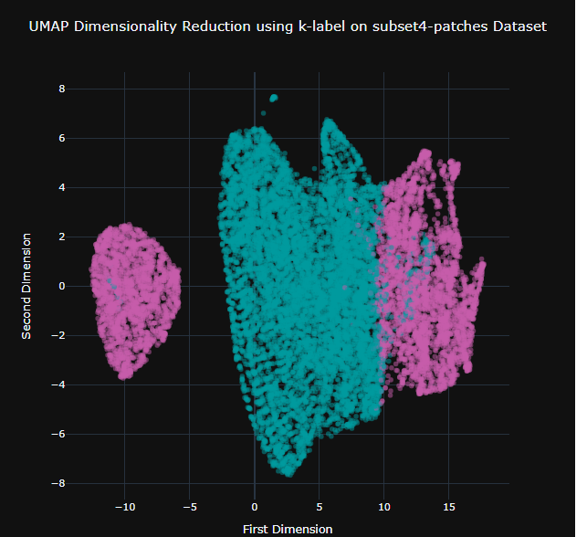
UMAP on patches SUBSET-4

Slide 25
Conclusion
UMAP and t-SNE give almost the same results, but UMAP clustering a bit better.
UMAP, t-SNE, PCA didn’t work well for clients-subset1 and clients-subset6
t-SNE can take life long to run
PCA is only good for basic cluster understanding.

